Slide 1
I agree to the Terms and Conditions.
(Please Refer to the T&C Document shared to SRM, before proceeding)

Slide 2



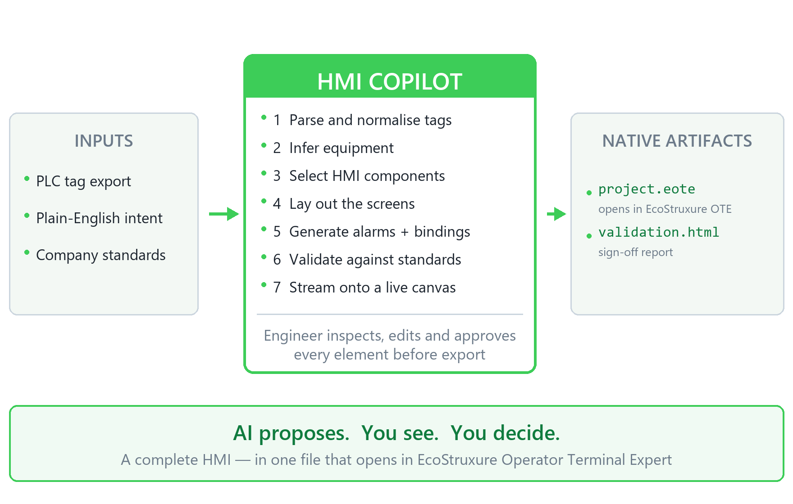

PROBLEM STATEMENT
TITLE
TEAM NAME & MEMBERS
HMI development is manual and expert-dependent. Engineers design screens, map hundreds of PLC tags and configure alarms by hand — causing errors, inconsistent HMIs and delays in commissioning.
HMI Copilot — AI-Powered HMI Project Generator
<Team name>
<Member 1, Member 2, Member 3>
PROPOSED SOLUTION
HMI Copilot converts a PLC tag list and natural-language requirements into a complete, validated EcoStruxure Operator Terminal Expert project.
Engineers provide a PLC tag export, plain-English requirements and their company HMI standards. The Copilot parses the tags, infers the equipment, selects the right components, lays out the screens, generates the alarms and bindings, validates everything, and exports a native .eote project.
Human-in-the-loop: engineers inspect, edit, redirect and approve every generated element before export.
Already working — a generated .eote opens directly in EcoStruxure Operator Terminal Expert, with its screen, tags, alarms and bindings already in place.
WHY THIS SOLUTION
TECHNOLOGY & TOOLS
Minutes instead of hours or days to produce a new equipment screen.
Automatic tag-to-object binding removes the most repetitive, error-prone step in the job.
Design-time validation catches naming, binding and type errors long before commissioning.
The AI encodes engineering standards, so screens stay consistent across the whole team — and every decision it makes is explained and auditable.
Most AI tools generate a design or some code. HMI Copilot generates the actual engineering artifact — and keeps the engineer in control.
Next.js · React · TypeScript
Inline SVG live preview
Zustand + Immer
Claude Opus 5, schema-
grounded generation
Node runtime backend
SheetJS · JSZip · SQL.js
JSON + SQLite artifacts
EcoStruxure OTE 4.4
Modbus / OPC-UA (sim)

Slide 3
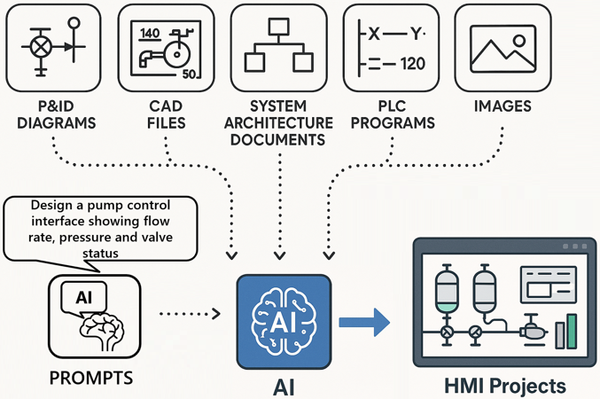
PROBLEM STATEMENT
TITLE
TEAM NAME & MEMBERS
<Put the problem statement you chose>
<Zenith>
<e.g. An Agent for the software>
<Asha, Nithin, Deepak>
PROPOSED SOLUTION
<Describe your proposed solution here. Add diagrams & pictures, if necessary, as shown>
WHY THIS SOLUTION
TECHNOLOGY & TOOLS
<Lists the technologies and tools you will use to implement the solution> e.g Python, Docker etc.
<Explain the reason for choosing the solution you proposed. Highlight unique abilities and competitive edge>

